Slide 1
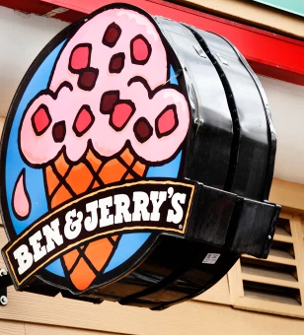
JAMES EHLER’SR
V.
BEN & JERRY’S
ICE CREAM
Student: ______________________
Course name:
Professor:

Slide 2
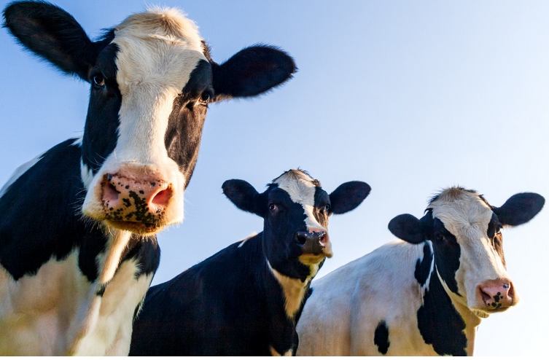
THE CASE
October, 29,2019: James Ehler filed a case against Ben &Jerry’s Ice cream company
Ben & Jerry’s Ice Cream was founded in 1978 by Ben Cohen and Jerry Greenfield in Burlington, Vermont but was in 2001 sold to Unilever.
Ben & Jerry’s Ice Cream advertises its products with a clause that the products come from “happy cows” cared for by “happy farmers”
James Ehler filed a legal suit that Ben & Jerry’s only joyrides on Vermont’s great name and standards but is misleading marketing enabled it to burnish its socially conscious image and charge higher prices for its ice cream, even though more than half the milk and cream was mass-produced.

Slide 3
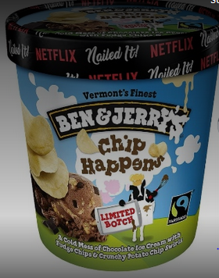
THE VERDICT
The jury ruled in favor of Ben& Jerry’s due to the following:
  The fine print on Ben & Jerry’s website makes it clear that not all of the ice cream is sourced from cows enrolled in the “Happy Dairy” program.
  The site also clarifies that only willing farms participate in the program.
  Further ,the company did not claim all its milk was sourced from “happy cows.”
  Additionally, the company has since removed the “happy” label from its packaging, leaving cartoon cows, hence there’s no possibility for future misleading advertising.

Slide 4
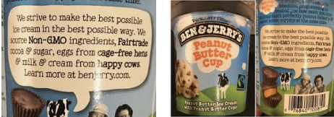
BEN & JERRY’S PACKAGING
YouTube Video Link: https://www.youtube.com/watch?v=U4NXY9Ws_js
The video shows the “happy cows on grass”
The images indicate the advertisement that Ehler claims deceptive due to the images of happy cows and the message conveyed.
Notes:
YouTube Link: http://www.youtube.com/watch?v=Vj5wo3BpAjk

Slide 5
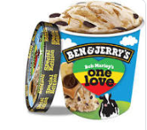
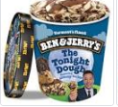
THE APPEAL
Plaintiff Ehlers has purchased the Phish Food, One Love, Americone Dream, Tonight Dough, Chocolate Chip Cookie Dough, Mint Chocolate Cookie, S'Mores, and New York Super Fudge Chunk varieties of Ben & Jerry's products
Ehler alleged that more than half the milk and cream used in Ben & Jerry's ice cream actually came from "factory-style, mass-production" dairy operations.
He further states that misleading marketing enabled Ben & Jerry's to charge premium prices, and violated a Vermont consumer protection law.
He states that Ben & Jerry’s and their parent company Unilever are taking advantage of standards set by the former management which they haven’t been able to keep.
Additionally, he claimed that such advertising posed a threat to the consumers who relied on the company information on being a healthy products producer.
The ruling of the case was on May 7th 2020.

Slide 6
WHAT DOES IT ALL MEAN?
Advertising injury: this entails the actions on a company in the process of advertising its products or services and the injured party can receive compensatory damages- Ben and Jerry’s are accused of misleading adverts making great profits at the detriment of the consumers.
Class actions: a legal file against the defendant by a group of people – Ehler on behalf of the consumers files a suit against the Ben& Jerry’s.
Commonality: These entails questions of the law that are common to the class members and are accorded more weight compared to individual questions:
          does the advert imply that the ice cream is exclusively from happy cows
          Does the company conceal material parts about the products
          Has the company retained ill-gotten gains from the class

Slide 7
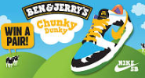
Cont.
    Ben &Jerry’s won the case because the plaintiff could hardly proof commonality. a
    Particularly, there is no clause that states that the ice cream comes from strictly happy cows and also the company does not give any succinct definition of what happy cows are. Moreover happy is not quantifiable.
    Judge Christina Reiss stated the following in her ruling , “[a] plaintiff who alleges that he was deceived by an advertisement may not misquote or misleadingly excerpt the language of the advertisement in his pleadings and expect his action to survive a motion to dismiss."
    Also, the class could not provide evidence of exploitation as a result of the advert and the label.

Slide 8
    Ben &Jerry’s won the case because the plaintiff could hardly proof commonality.
    Express warranty: this is a statement that is created by a seller that that is either a fact or guarantee on the products sold and forms bargain basis and grounds to complain if the product fail to meet the promised fact or quality.
    Ben and Jerry’s haven’t stated any precise warrant.
    Accordingly, the court held that “because neither Ben & Jerry’s products nor its website represents that its ingredients are “sourced exclusively” from Caring Dairy farms, Plaintiff’s entire claim is grounded on a single phrase in a single heading on a multipage website which is neither false nor misleading when considered as a whole

Slide 9
HOW TO PROTECT YOUR COMPANY
Ben & Jerry’s has now dropped the claim on their packaging that their products come from “happy cows”. This will eliminate any controversies on the nature of their products .
By stating clearly what the ice creams and other products are made of, Ben and Jerry’s can avoid the risk of false advertising .
Giving precise and non-committal information, a company does not perform its social duty but also avoid any bidding clauses that could be used against it.

Slide 10
References
Organic Consumers Association. (2020, January 16). Ben & Jerry's stops calling cows 'Happy' after being sued for false advertising. PR Newswire: press release distribution, targeting, monitoring and marketing. https://www.prnewswire.com/news-releases/ben--jerrys-stops-calling-cows-happy-after-being-sued-for-false-advertising-300988510.html
Ben & Jerry's ice cream not sourced from 'Happy cows,' suit claims. (2019, November 11). Findlaw. https://blogs.findlaw.com/legalgrounds/2019/11/ben.html
Foodnavigator-usa.com. (2019, November 14). Happy cows? Ben & Jerry’s sued again over milk sourcing: ‘You will most certainly see more cases like this,’ predicts attorney. foodnavigator-usa.com. https://www.foodnavigator-usa.com/Article/2019/11/14/Happy-Cows-Ben-Jerry-s-sued-again-over-milk-sourcing

